Slide 1

Visual Communication
Vaishnavi

Slide 2

Definition
Visual communication is the practice of using visual elements to get a message across, inspire change, or evoke an emotion.

Slide 3

Perfect MVP
Communication design refers to crafting a message that educates, motivates, and engages the viewer.
Graphic design uses design principles to communicate that message in a way that is clear and eye-catching to the intended audience.

Slide 4
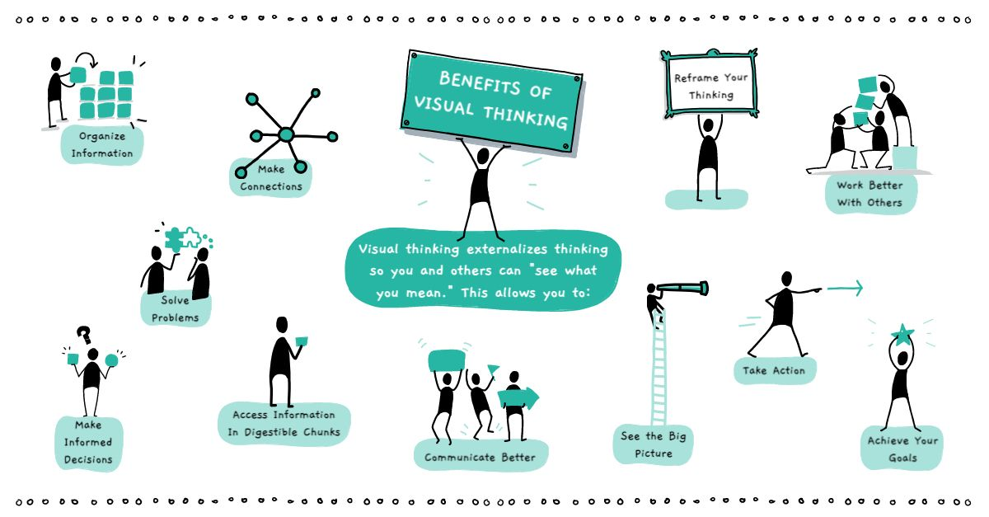
Definition
Visual communication is the practice of using visual elements to get a message across, inspire change, or evoke an emotion.

Slide 5

Strategies
Unique
Tested
Showing the impact of your work by using data visualization
Telling stories through visuals and data
Elephant
Authentic
Creating more memorable information through the use of symbols and icons
Harnessing color to illustrate importance and attract attention

Slide 6

Examples

Slide 7
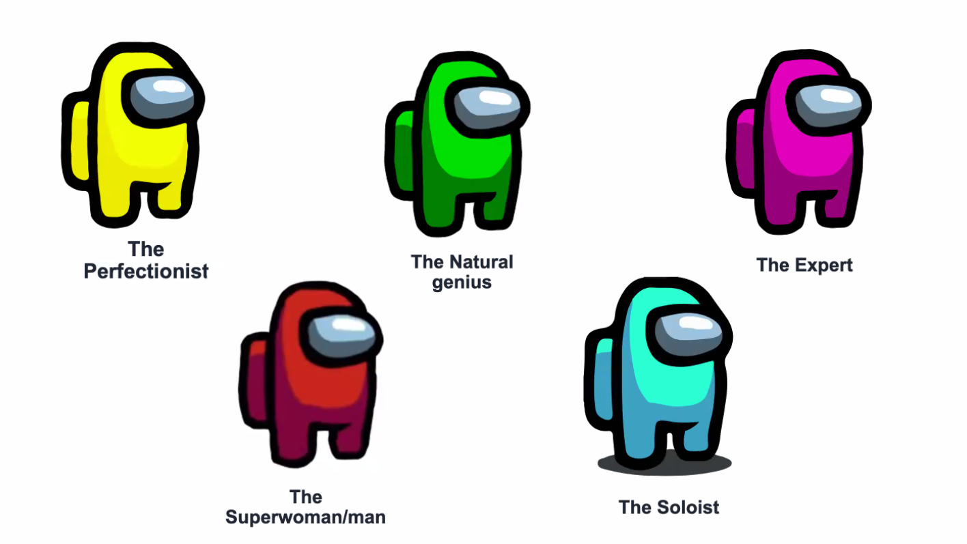
Imposter

Slide 8
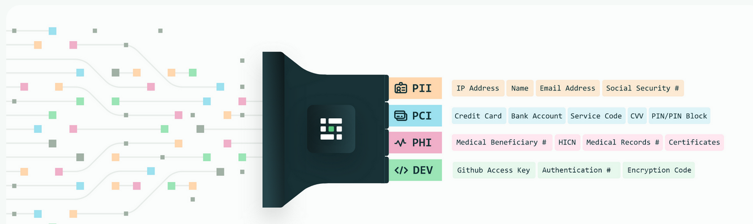
Privacy

Slide 9
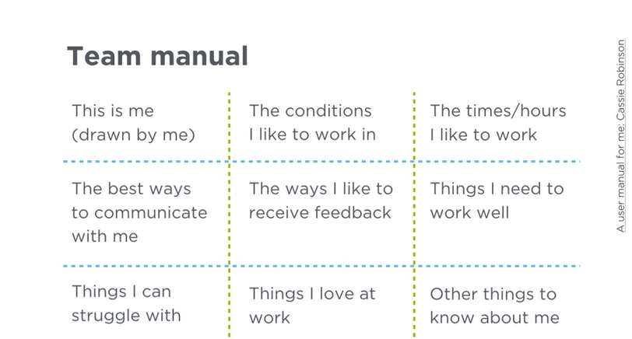

Slide 10
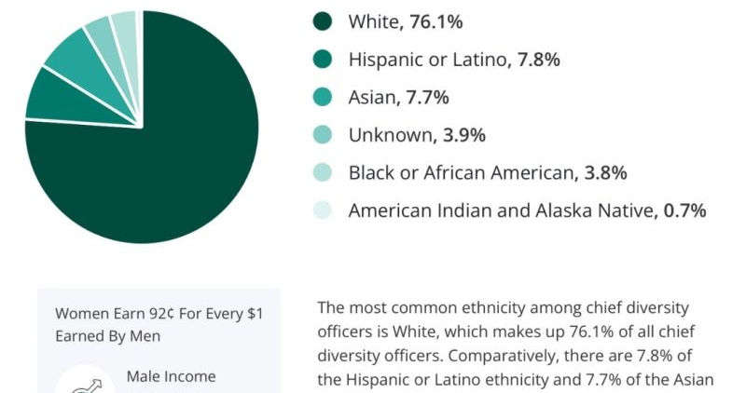
Colors?

Slide 11
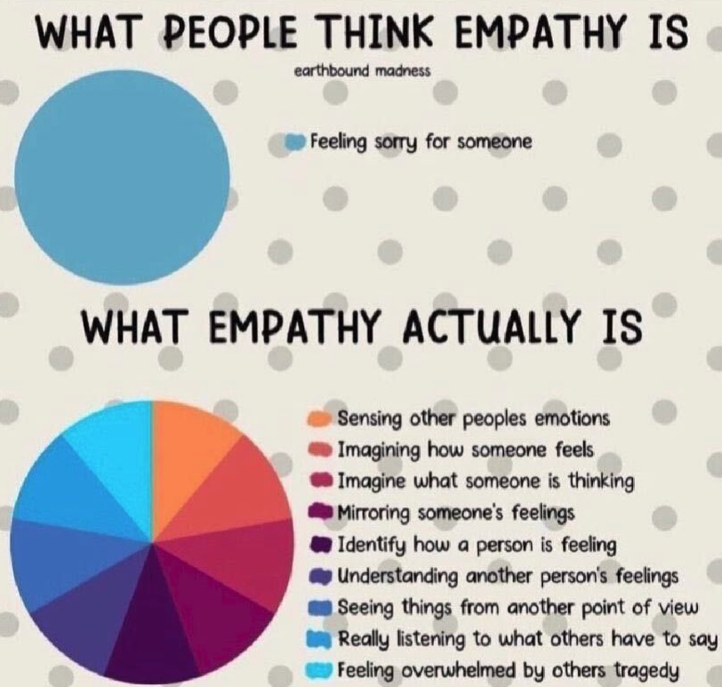
Colors?

Slide 12
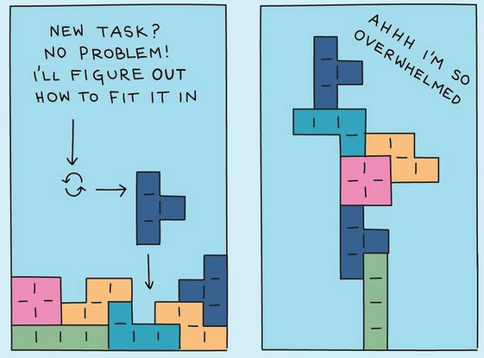
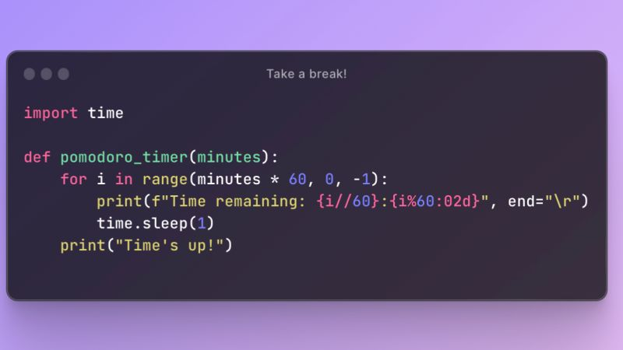

Ideas
$3B
$2B
$ 1B
Opportunity to build
Fully inclusive market
Total addressable market
Freedom to invent
Selectively inclusive market
Serviceable available market
Few competitors
Specifically targeted market
Serviceable obtainable market

Slide 13
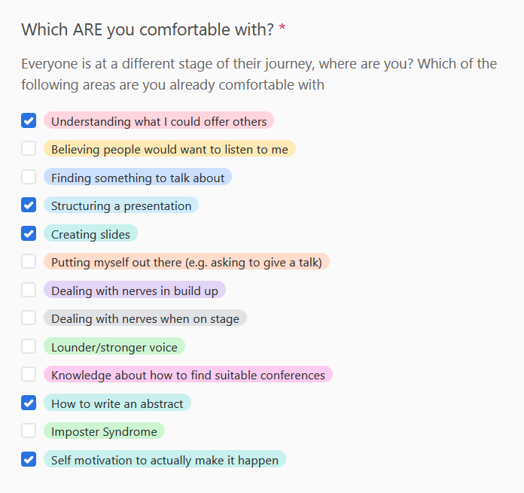
Ideas
$3B
$2B
$ 1B
Opportunity to build
Fully inclusive market
Total addressable market
Freedom to invent
Selectively inclusive market
Serviceable available market
Few competitors
Specifically targeted market
Serviceable obtainable market

Slide 14
Problem
Market gap
Financials
Few, if any, products on the market help customers like we do
Millennials account for about a quarter of the $48 billion spent on other products in 2018
Customers
Costs
66% of US consumers spend money on multiple products that only partially resolves their issue
Loss of productivity costing consumers thousands of dollars

Slide 15

Solution
Close the gap
Our product makes consumer lives easier, and no other product on the market offers the same features
Target audience
Gen Z (18-25 years old)
Cost savings
Reduce expenses for replacement products
Easy to use
Simple design that gives customers the targeted information they need

Slide 16



Business model
Research
Abstract
Design
We based our research on market trends and social media
We believe people need more products specifically dedicated to this niche market
Minimalist and easy to use

Slide 17



Market comparison
$3B
Opportunity to build
Addressable market
$2B
Freedom to invent
Serviceable market
$1B
Few competitors
Obtainable market

Slide 18
Our competition
Contoso
Competitors
Our product is priced below that of other companies on the market
Design is simple and easy to use, compared to the complex designs of the competitors
Affordability is the main draw for our consumers to our product
Company A Product is more expensive
Companies B & C Product is expensive and inconvenient to use
Companies D & E Product is affordable but inconvenient to use

Slide 19
Competitive layout
CONVENIENT
A
Contoso
EXPENSIVE
AFFORDABLE
D
C
E
B
INCONVENIENT

Slide 20
Growth strategy
How we’ll scale in the future
Feb 20XX
May 20XX
Oct 20XX
Roll out product to high profile or top-level participants to help establish the product
Release the product to the general public and monitor press release and social media accounts
Gather feedback and adjust product design as necessary

Slide 21
Traction
Forecasting for success
Key metrics
Revenue by year
 | Clients | Orders | Gross revenue | Net revenue
20XX | 10 | 1100 | $10,000 | $7,000
20XX | 20 | 200 | $20,000 | $16,000
20XX | 30 | 300 | $30,000 | $25,000
20XX | 40 | 400 | $40,000 | $30,000

Slide 22
Two-year action plan
Draft blueprints
Run focus groups
Gather feedback
20XX
JAN
FEB
MAR
APR
MAY
JUN
JUL
AUG
SEP
OCT
NOV
DEC
20XX
JAN
FEB
MAR
APR
MAY
JUN
JUL
AUG
SEP
OCT
NOV
DEC
Test design
Launch design
Deliver to client

Slide 23
Financials
 | Year 1 | Year 2 | Year 3
Income
Users | 50,000 | 400,000 | 1,600,000
Sales | 500,000 | 4,000,000 | 16,000,000
Average price per sale | 75 | 80 | 90
Revenue @ 15% | 5,625,000 | 48,000,000 | 216,000,000
Gross profit | 5,625,000 | 48,000,000 | 216,000,000
Expenses
Sales & marketing | 5,062,500 | 38,400,000 | 151,200,000 | 70%
Customer service | 1,687,500 | 9,600,000 | 21,600,000 | 10%
Product development | 562,500 | 2,400,000 | 10,800,000 | 5%
Research | 281,250 | 2,400,000 | 4,320,000 | 2%
Total expenses | 7,593,750 | 52,800,000 | 187,920,000

Slide 24




Meet the team
Takuma Hayashi
Mirjam Nilsson
Flora Berggren
Rajesh Santoshi
President
Chief Executive Officer
Chief Operations Officer
VP Marketing

Slide 25








Meet the team
Takuma Hayashi
Mirjam Nilsson
Flora Berggren
Rajesh Santoshi
President
Chief Executive Officer
Chief Operations Officer
VP Marketing
Graham Barnes
Rowan Murphy
Elizabeth Moore
Robin Kline
VP Product
SEO Strategist
Product Designer
Content Developer

Slide 26
Funding
Properties
Angel investments
Cash
Shares
$12,000
$14,000
$32,000
$82,000
Revenue obtained from property rentals
Amount obtained through other investors
Liquid cash we have on hand
Number of shares converted into USD

Slide 27

Summary
At Contoso, we believe in giving 110%. By using our next-generation data architecture, we help organizations virtually manage agile workflows. We thrive because of our market knowledge and great team behind our product. As our CEO says, "Efficiencies will come from proactively transforming how we do business."

Slide 28


Thank you

